Slide 1

Force Probe
By Jeffrey Wen
ELECTRICAL AND COMPUTER ENGINEERING, COLLEGE OF ENGINEERING AND APPLIED SCIENCE

Slide 2
Goals
Develop a device that can detect push and pull forces in Newtons
Gain an introduction into Force Sensitive Resistors (FSR)
Understand how the Serial Plotter can be used with sensors

Slide 3
Applicable Education Standards
See Next Generation Science Standards:
https://www.nextgenscience.org/sites/default/files/AllTopic.pdf

Slide 4
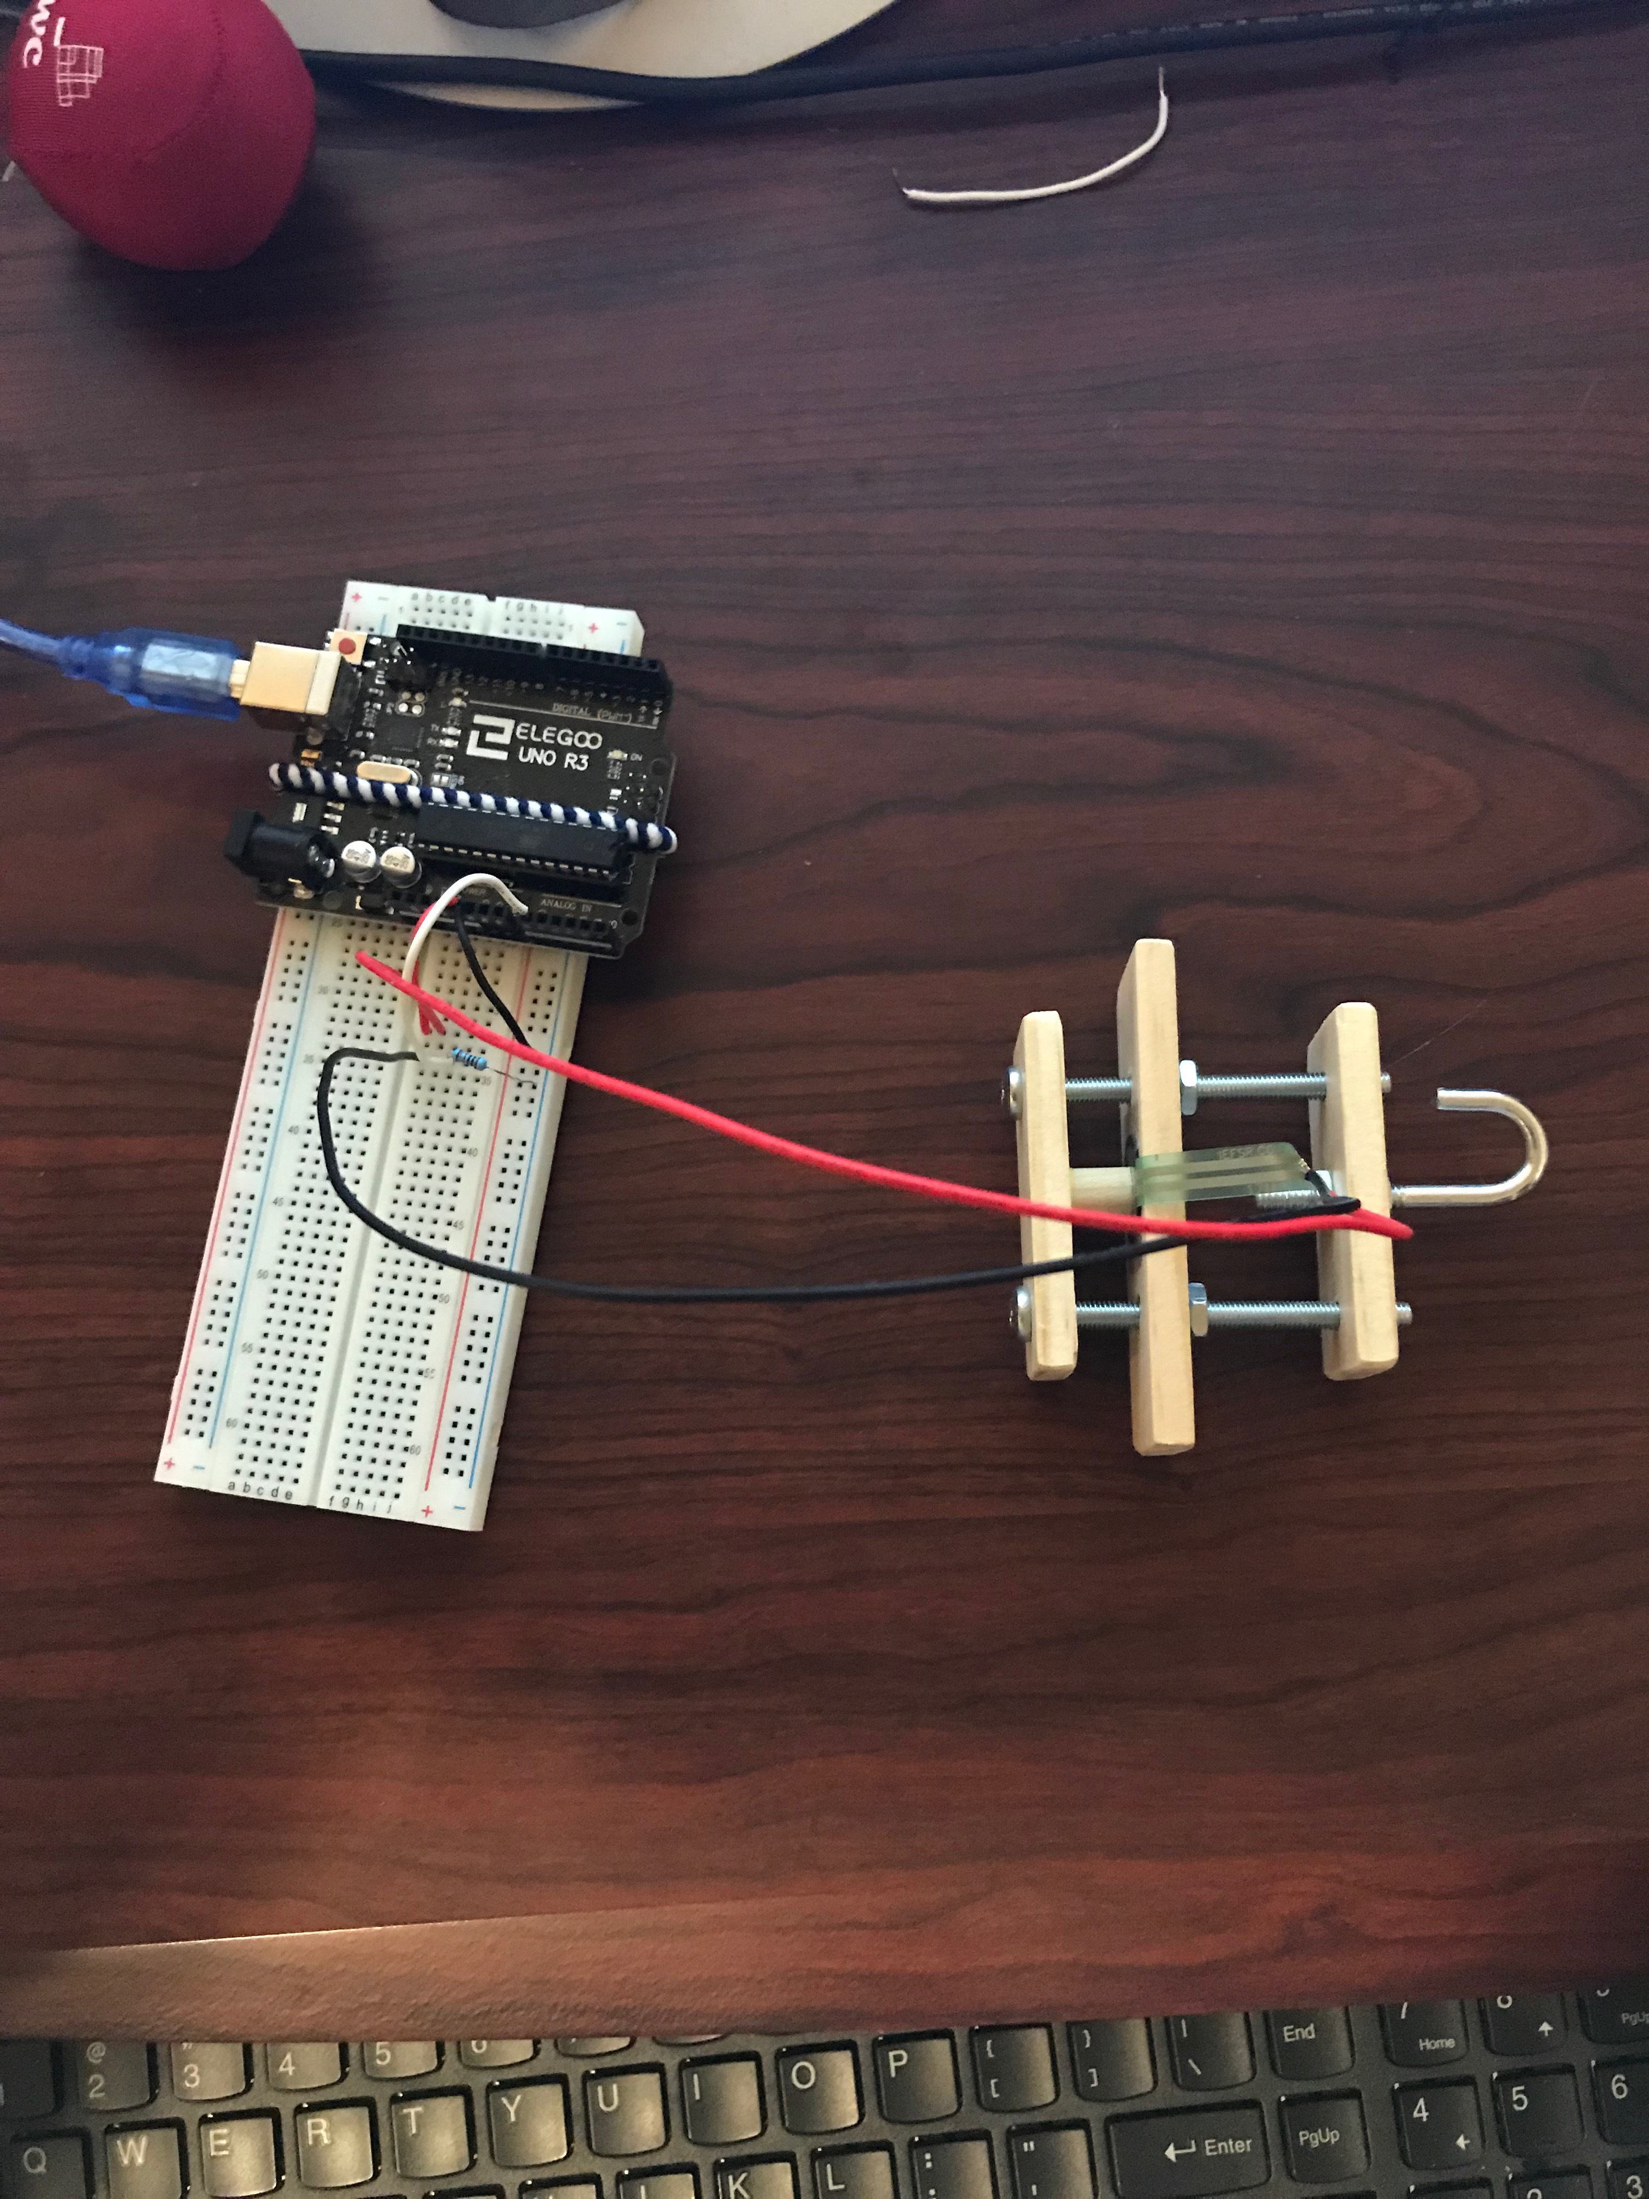
Abstract
This module uses a force sensitive resistor (FSR) to sense the amount of force being applied during a push or pull. With the use of the Serial Plotter, the user can get a plot of the amount of force over time.

Slide 5
Materials
1 – Arduino UNO
1 – Force Probe Setup
1 – Force Sensitive Resistor ($6.95)
1 – 10kΩ resistors

Slide 6
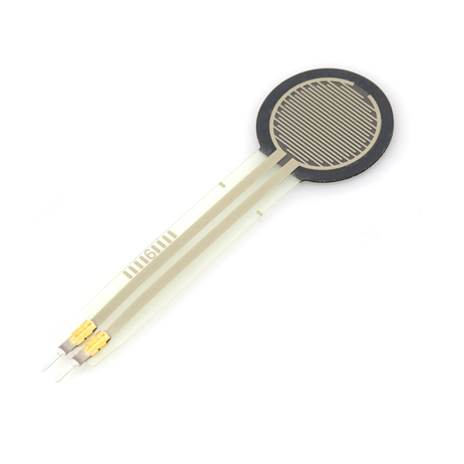
Force Sensitive Resistor (FSR)
A FSR has a lower resistance when a larger force is applied to it
The resistance will vary from 1MΩ with no pressure to 200Ω with max pressure
The sensor can detect forces from 0 to 100 Newtons (22lbs)

Slide 7
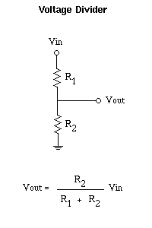
Voltage Divider
The diagram shows a voltage divider setup required to read the FSR. Two resistors are connected in series, and the voltage at their connection, Vout , is read.​
  The equation uses the values of the input voltage (Vin) and both resistor values to find (Vout). It will be a fraction of the input voltage.​
  As the FSR’s resistance varies so does the output voltage.​
= FSR
= 10kΩ

Slide 8
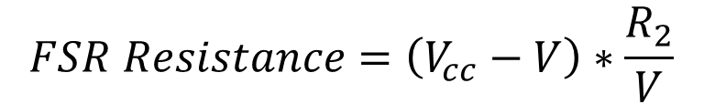
Detecting the Force Applied
With a voltage divider, the Arduino can only detect changes in the voltage coming in
To relate that to a resistance, we’ll use the equation
Then, we’ll want to convert from resistance to conductance (in micromhos): Conductance = 1M / FSR Resistance
$$FSR Resistance=\left(V_{cc}−V\right)∗\frac{R_{2}}{V}$$
Where: Vcc = Source Voltage (5V)
V = Voltage Detected by Arduino
R2 = Resistance of Second Resistor in the voltage divider (10kΩ)

Slide 9
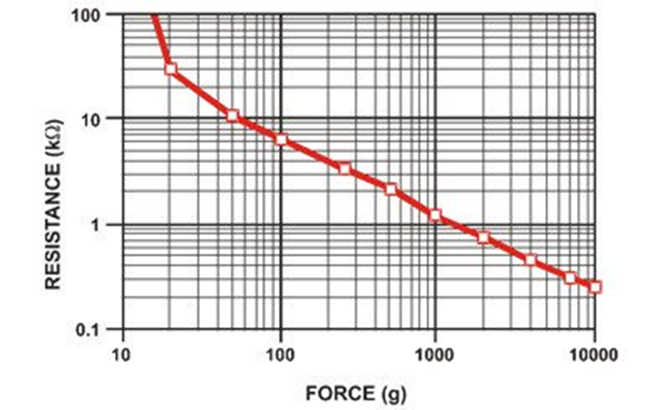


Detecting the Force Applied
The FSR works according to a relationship similar to the plot to the right
The relationship between the resistance and force is not perfectly linear but can be approximated as such with two piece-wise functions
(N)
$$Force=\frac{Conductance}{80}$$
For Conductance <= 1000
For Conductance >1000
$$Force=\frac{Conductance −1000}{30}$$
Note: Equations and plot provided by the manufacturer. If using a different force probe, may need a different equation

Slide 10
The Force Probe
FSR
A force probe was created to direct push and pull forces onto a FSR, so that the forces may be detected
When the hook is pulled or the front wood peg is pushed, a small wooden dowel is pushed onto a FSR
Front (to be pushed)
Wood Dowel
Hook (to be pulled)

Slide 11
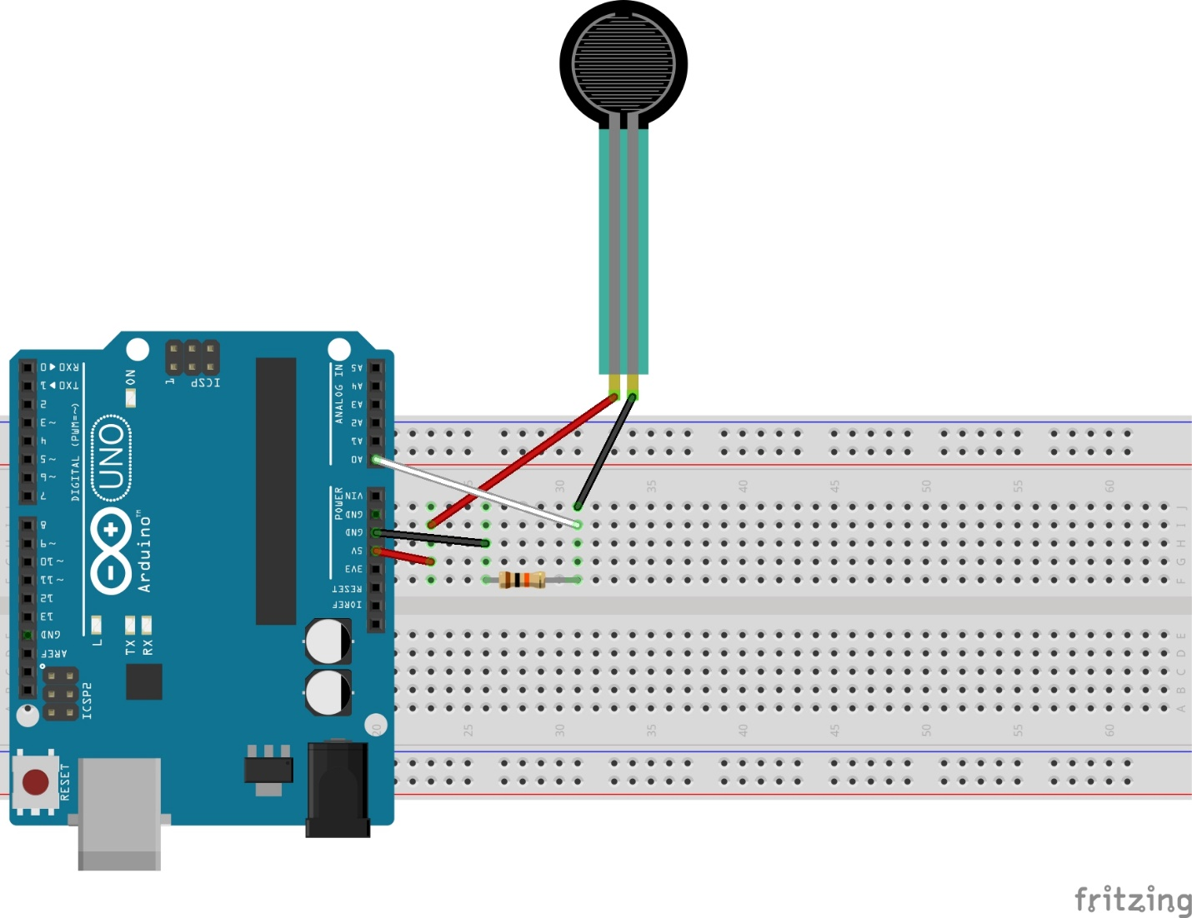
Circuit Diagram
Force Sensitive Resistor
Note: The FSR will already be in the Force Probe, so just connect the wires from probe
10kΩ Resistor

Slide 12
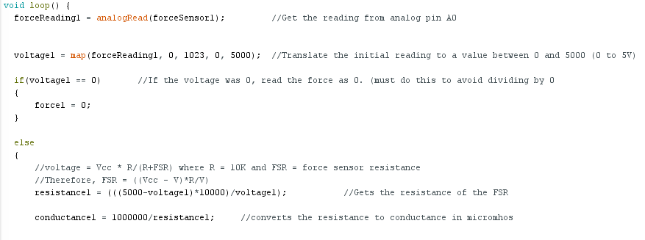
Code
Open “ForceProbeSkeleton.ino” and type the following code:

Slide 13
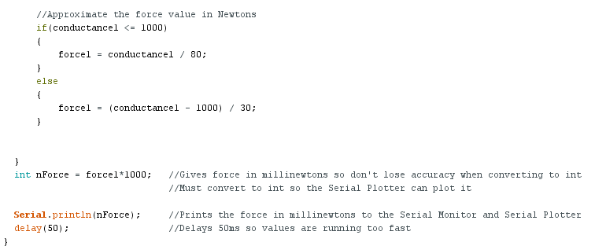
Code: Continued

Slide 14
Try it out
Upload the code to the Arduino
Open the Serial Monitor in the top right-hand corner
Values will start streaming down the screen
Hold the middle wood piece of the force probe still and pull the hook to see how the value changes
Note: if you are not getting 0 when there is no force, the FSR is too tight against the dowel. Loosen the nuts below the middle wood piece slightly until the values read 0

Slide 15
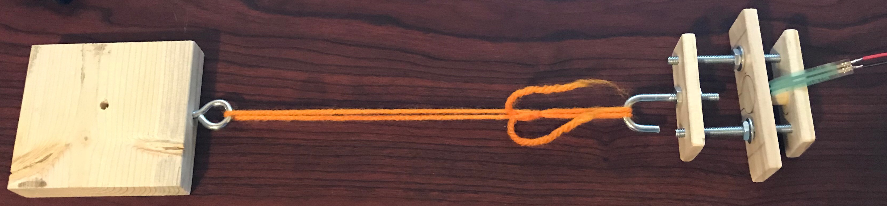
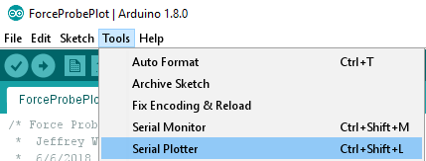
Applications: Testing for the Coefficient of Friction
Get a block and attach it to the hook as in the picture below
Add a weight to the block
In the Arduino IDE, go to Tools -> Serial Plotter

Slide 16
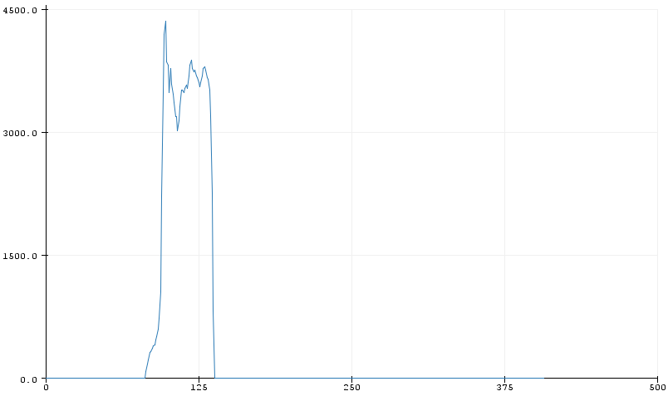
Testing for the Coefficient of Friction
Once the Serial Plotter is up, pull on the force probe using the middle wooden piece
You should get a plot like the one below:
Force to maintain a constant velocity
Force needed to overcome static friction
Note: It may take several tries to get a plot like the one below. Try it multiple times to get a baseline of what your values should look like. The way you hold it may affect what values you get.

Slide 17
Calculating the Coefficient of Friction
Try the experiment several times with different weights (this will typically work better with heavy weights)
To find the coefficient of static friction, you would make a table of normal force vs. max (peak) force
Then, plot the results in Excel and have it produce a best fit linear equation. The linear coefficient should be the coefficient of static friction

