Slide 1
Processing and Analysis of Behavioral Data During a Saccadic Eye Movement Task
By: Jeffrey Wen
With: Dr. Nategh, Amir Akbarian

Slide 2
Introduction
Visual systems use rapid eye movements, saccades, to bring objects of interest into focus for further processing
Previous studies have found different temporal and spatial phenomenon in perception during saccades
  Perceived Spatial Compression (Morrone et al,. 1997)
  Perceived Temporal Compression (Ross et al,. 2005)
What effects in temporal perception can be seen with the comparison of perisaccadic visual stimuli and fixation auditory stimuli?
Does the spatial location of stimuli play a role in temporal perception?

Slide 3
The Experiment: Temporal Perception Mapping with Fixed Visual Duration
The Experiment:
Goal: To examine the effects of saccades and stimulus location on perceived time
Primary Deliverables: Plots illustrating the observed temporal effects and a literature-based hypothesis for the cause
Signals
Target
Fixation
Eye Position
Fixation
Target
1 2 3 4 5 6 7
Location
Visual Stimuli
Auditory Stimuli

Slide 4
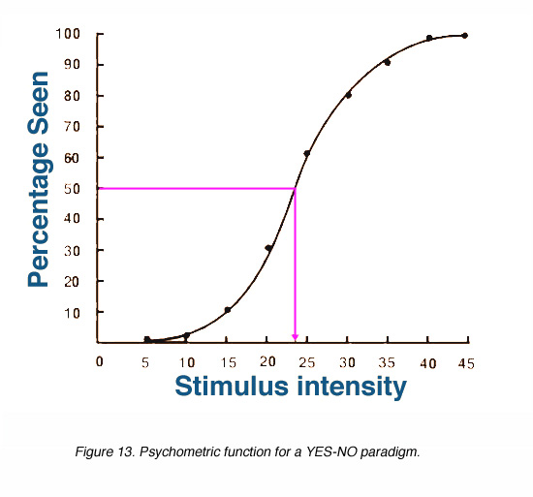
Methods: Psychometric Function
Psychometric Function: the relationship between a change in stimulus and a subject’s response (a model used for quantifying detection or discrimination tasks)
Obtained by fitting a Gaussian cumulative distribution function over the measured responses
Point of Subjective Equality (PSE) – the point which the subject is equally likely to answer one way as the other
PSE

Slide 5
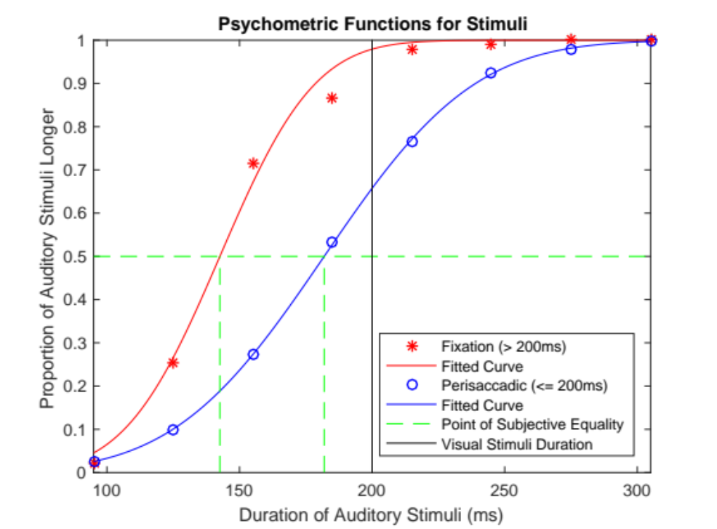
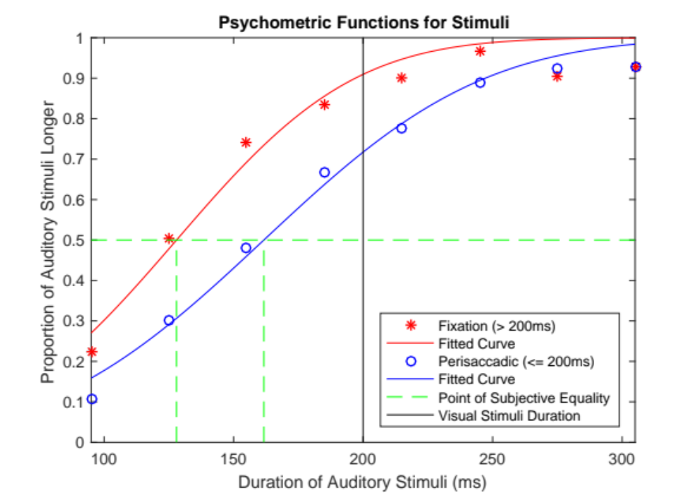
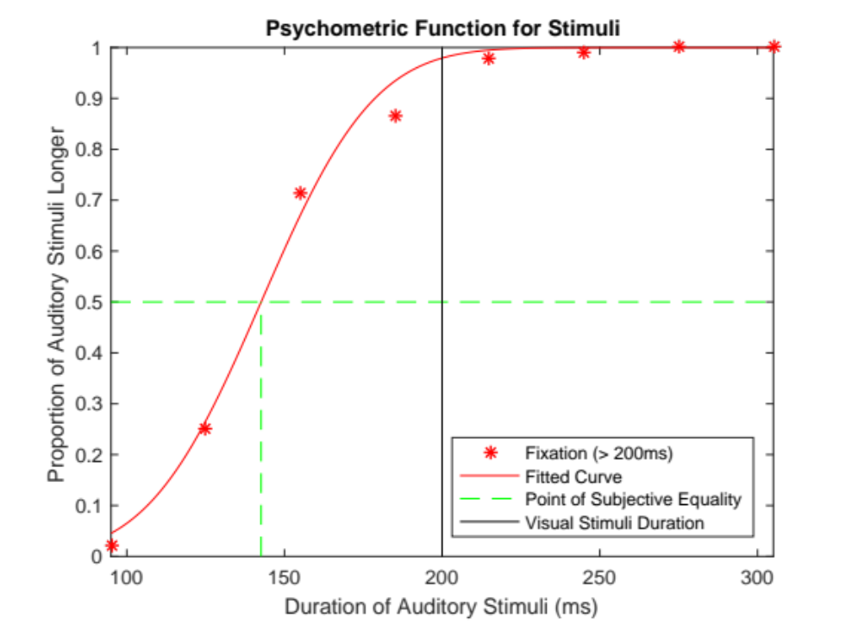
Results: Perceived Time Expansion During
Saccade
Fixation PSE = 143 ms
Perisaccadic PSE = 182 ms
Shift in PSE to the right: temporal expansion (39 ms)
Shift in PSE to the right: temporal expansion (34 ms)
Subject MC
Subject RJ

Slide 6
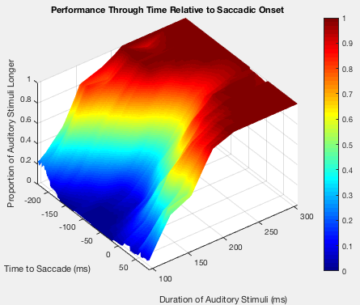
Results: Psychometric Functions Across Time Relative to Saccade
Allows us to see the change in PSE across time
Maximum PSE occurs between 100ms to 50ms before saccade

Slide 7
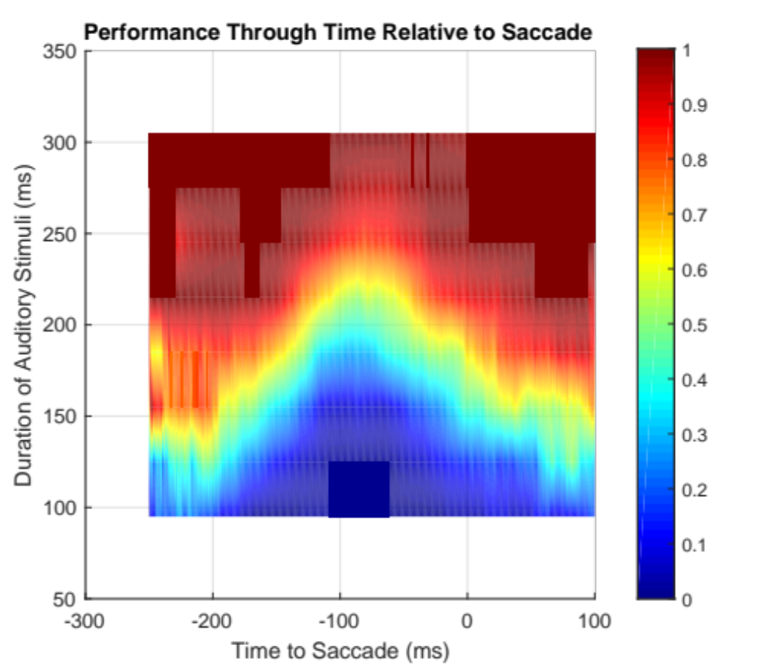
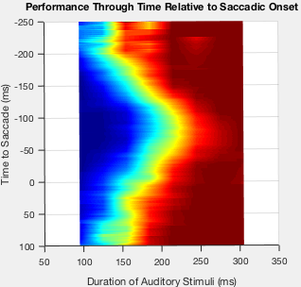
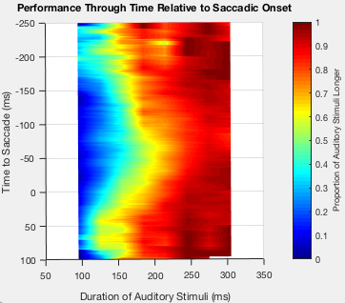
Maximum PSE between 100ms and 50ms before Saccade
Subject MC
Subject RJ

Slide 8
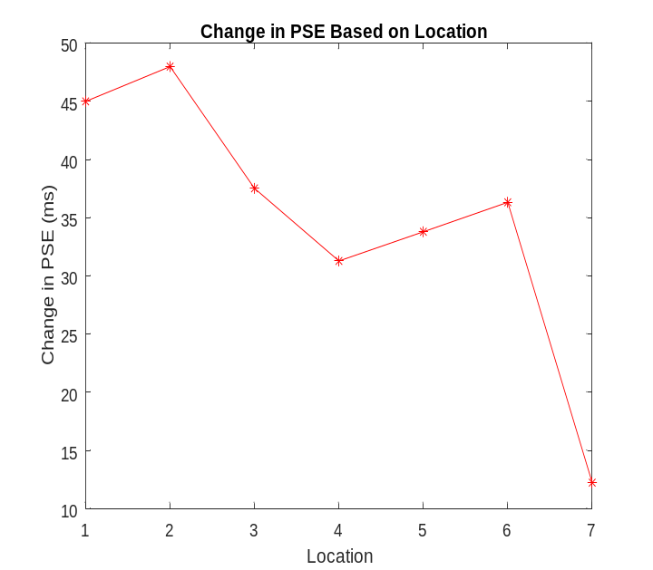
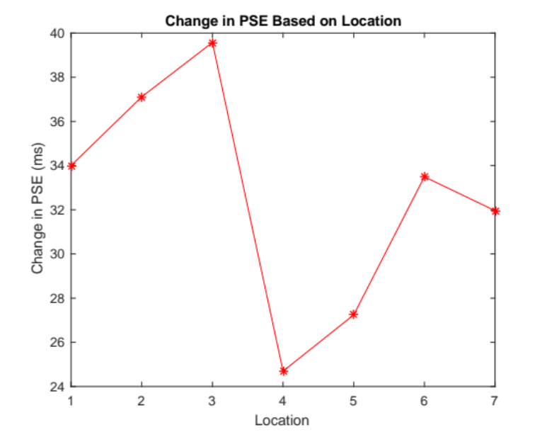
Results: Temporal Effects as a Function of Spatial Location
Target
Fixation
General Trends:
  Maximum or local maximum around Location 2 and 6
  Minimum or local minimum around Location 4
1 2 3 4 5 6 7
Location
Subject MC
Subject RJ

Slide 9
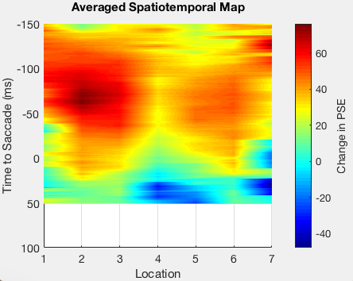
Results: Change in PSE Varies By Location
Target
Fixation
Peaks at Location 2 and 6
Valley at Location 4
Maximums occur between 100ms to 50ms before saccade
1 2 3 4 5 6 7
Location

Slide 10
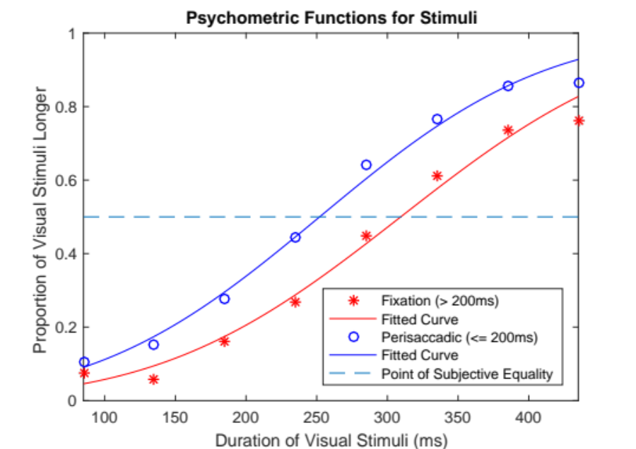
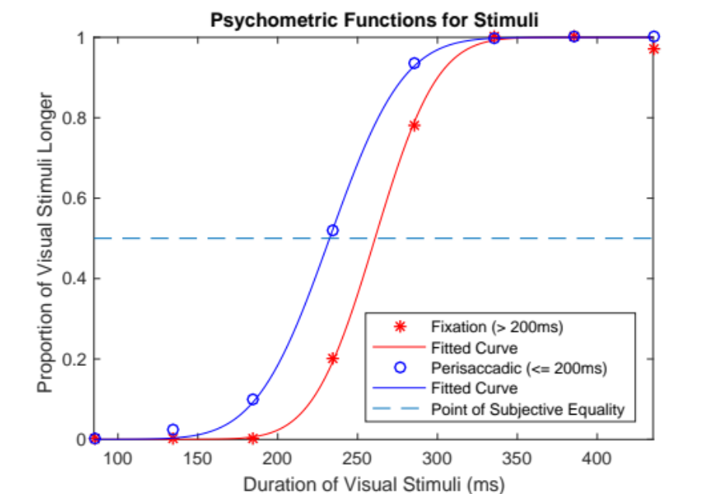
Verification: Temporal Perception Mapping – Auditory Stimuli Fixed
Same experimental setup except the auditory stimuli duration was fixed and visual stimuli duration was varied
Same result of perceived temporal expansion
Subject AA
Subject MC

Slide 11
Discussion
Temporal expansion effect seen when the delay between visual stimuli occurs during saccade
The temporal expansion is similar to that seen during chronostasis
  Chronostasis is a perceived expansion of time after a voluntary action (Park et al., 2003)
  Believed to be a result of the brain increasing the speed of its internal clock ticks during saccade (Park et al., 2003)
Additional experiments could tell if saccade size makes a difference or if expansion is proportional to the delay duration
Previous studies have found auditory stimuli is perceived as longer than visual stimuli (Wearden et al., 2006) due to shorter internal clock ticks
Visual Probe 1
Start of Effect
200ms Delay
Maximum Effect
Visual Probe 2
End of Effect
Saccade Window

Slide 12
Acknowledgements
Dr. Nategh, Project Mentor
Amir Akbarian, Project Mentor
Dr. Repasky, REU Organizer
Dr. Nakagawa, REU Organizer
The National Science Foundation, Sponsor

