Slide 1

Laser Gate Timing System
By Jeffrey Wen
ELECTRICAL AND COMPUTER ENGINEERING, COLLEGE OF ENGINEERING AND APPLIED SCIENCE

Slide 2
Goals
Develop a timing system, which utilizes the Arduino’s fast internal clock to provide an accurate timing system for kinematic experiments
Understand how to time events using Arduino’s built-in function millis()

Slide 3
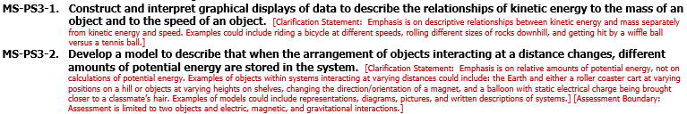
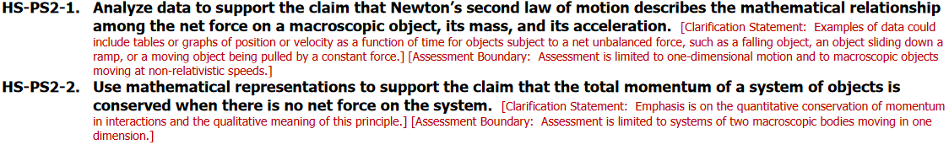
Applicable Education Standards
See Next Generation Science Standards:
https://www.nextgenscience.org/sites/default/files/AllTopic.pdf

Slide 4
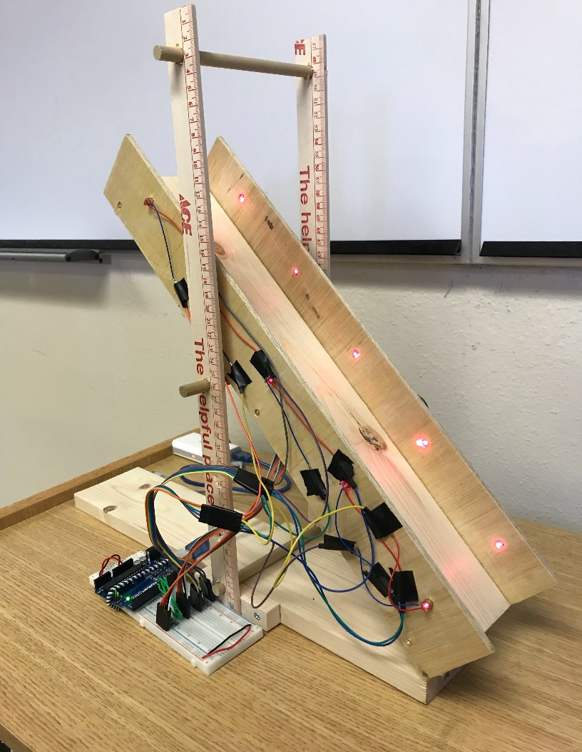
Abstract
This module uses laser gates to detect when an object passes through a gate. The Arduino records the time when an object crosses a gate. Used with the provided ramp, the module can be used for a variety of kinematic experiments

Slide 5
Materials
1 – Arduino UNO
1 – Ramp
5 – Laser Didoes (10 for $5.49)
5 – Photoresistors (30 for $5.59)
5 – 1kΩ resistors
5 – 10Ω resistors

Slide 6
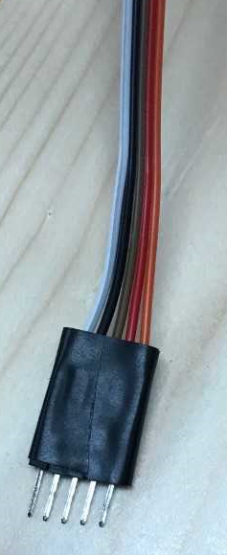
Building the Circuit
The ramp provided already has wires connected to the photoresistors and laser diodes.
These wires are connected to a ribbon of wires for convenience; therefore, simply plug in the ribbon for the lasers or photoresistors to the corresponding spot on the breadboard (next slide)

Slide 7
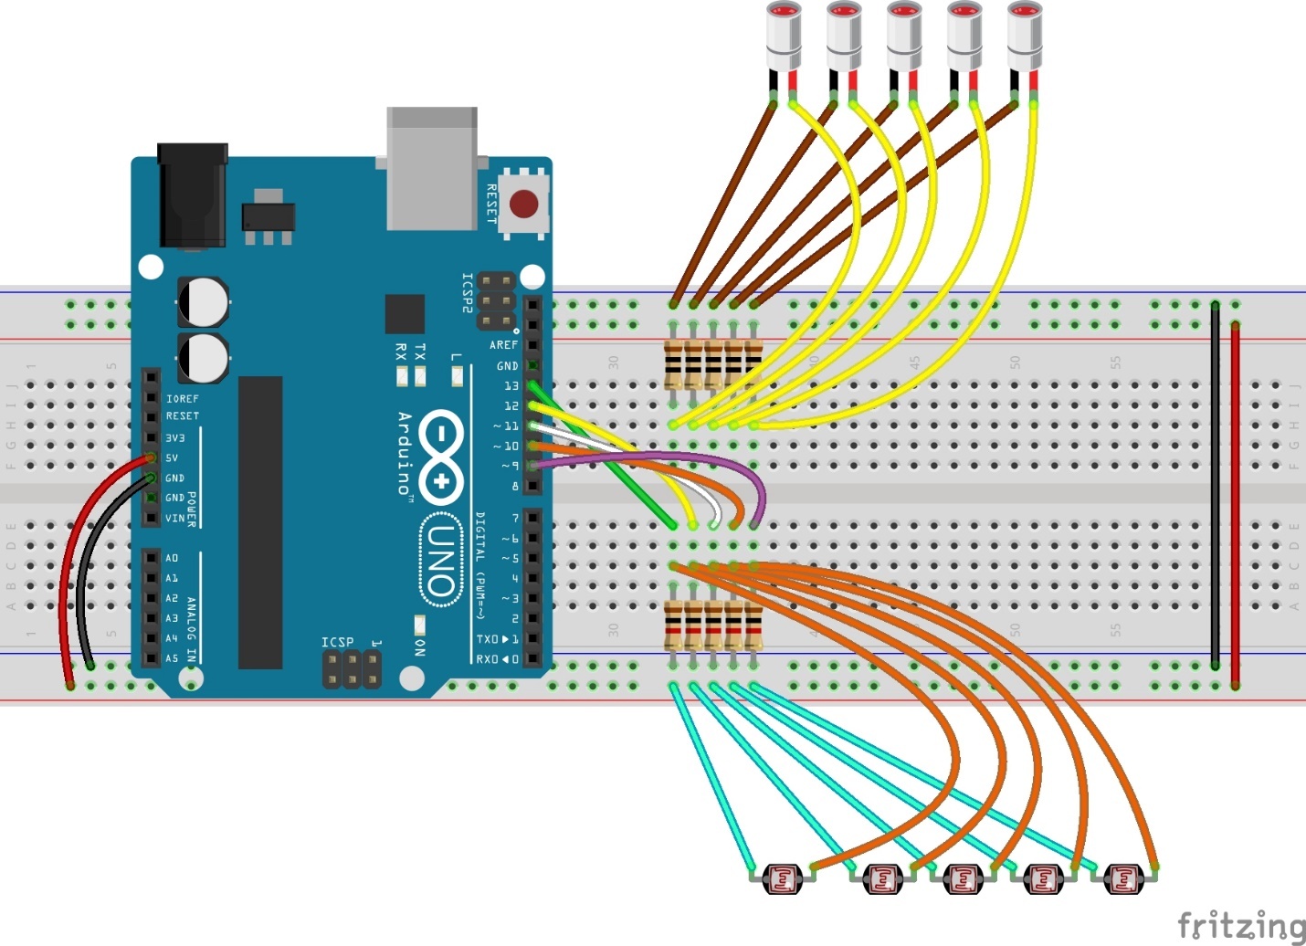
Circuit Diagram
Laser Diodes
10Ω Resistors
1kΩ Resistors
Notes: Collection of same colored wires are a ribbon.
Connect everything except the ribbons, then see next slides
Photoresistor 1

Slide 8
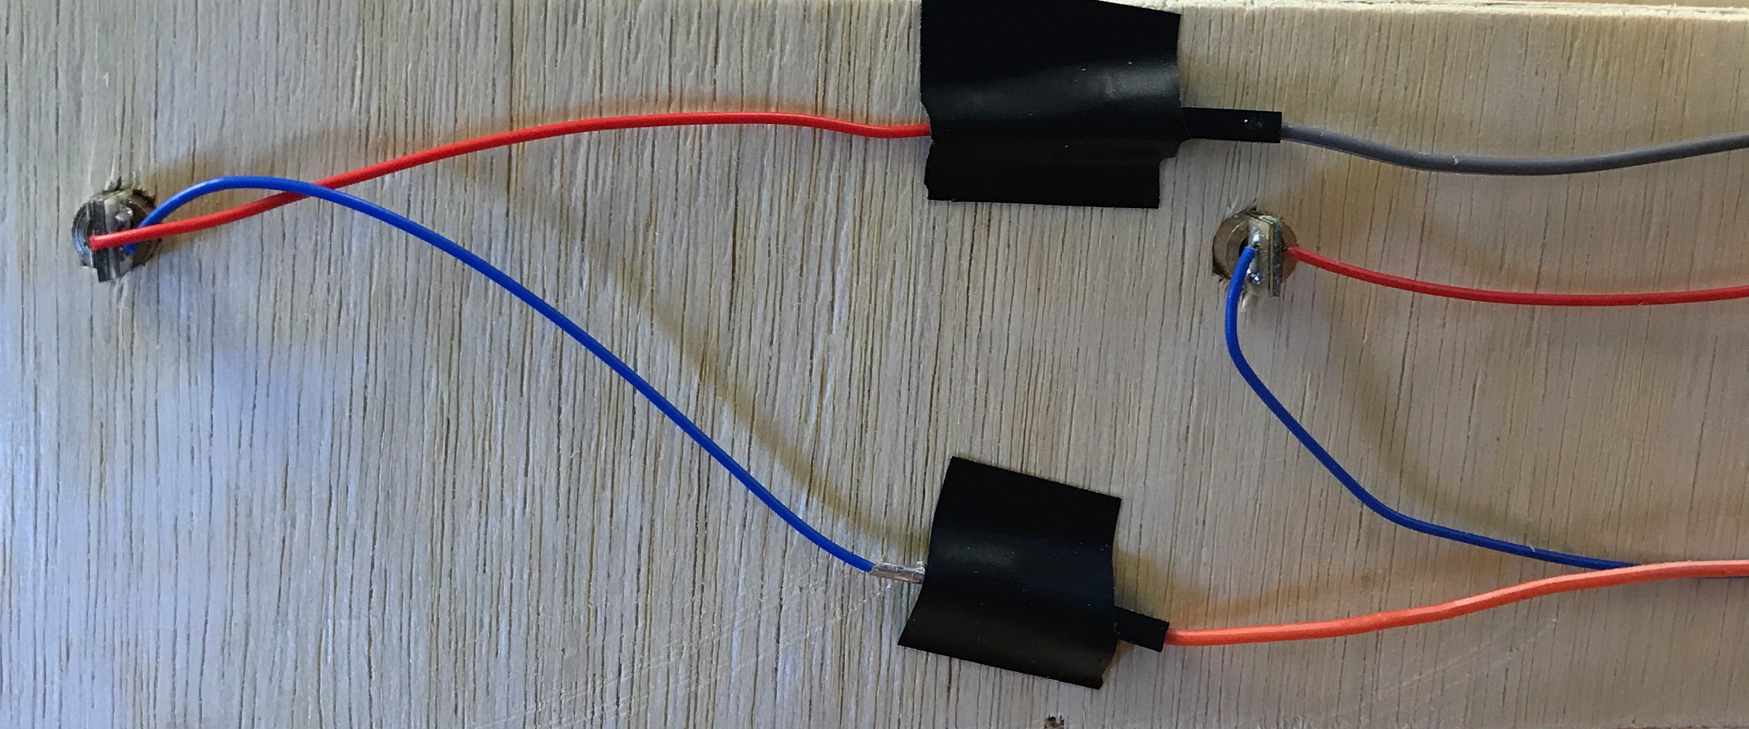
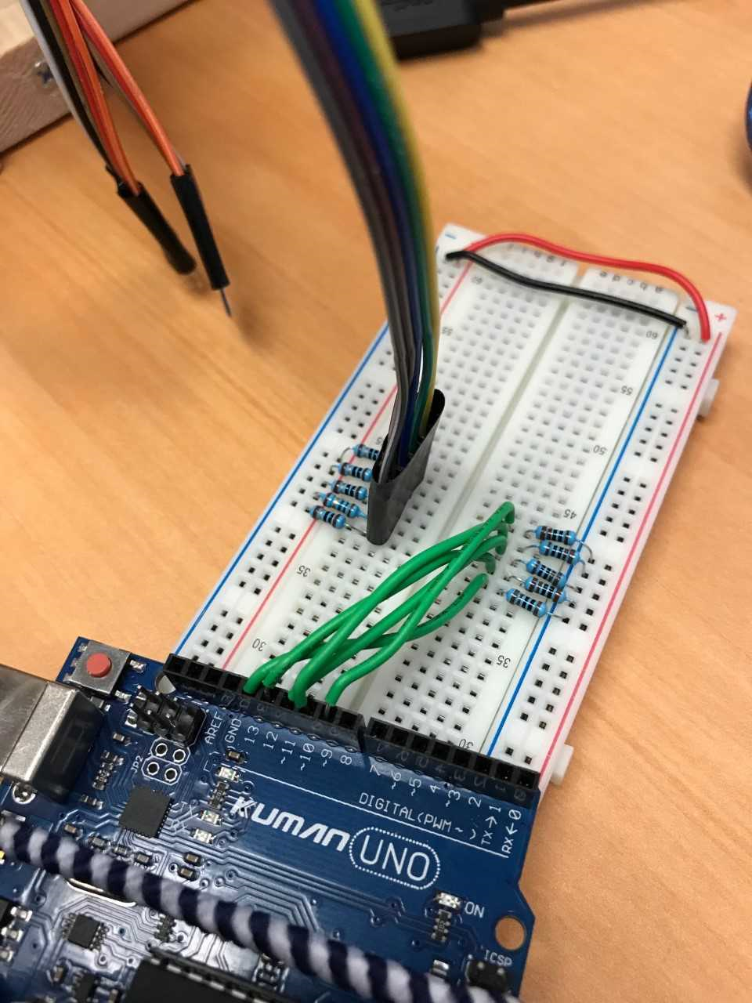
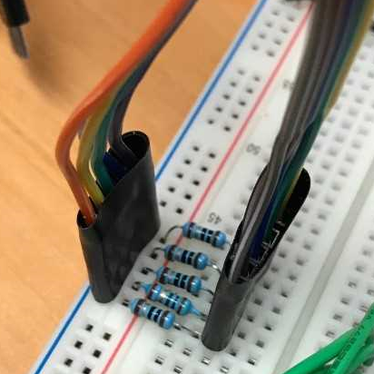
Connecting the Laser Ribbons
For the lasers, see which ribbon is connect to all of the red wires on the lasers.
Connect that ribbon with the 10Ω resistors
Connect the other laser ribbon to ground

Slide 9
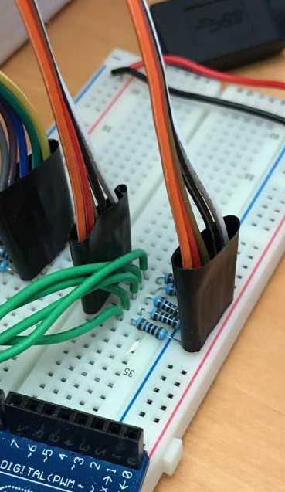
Connecting the Photoresistor Ribbons
The two ribbons will be the same color
Find which wire is connected to photoresistor 1 (top of the ramp)
Make sure that wire on the ribbon is facing the Arduino (as in the circuit diagram)
Connect one of the ribbons to power and the other with the 1kΩ resistors (Does not matter which ribbon)

Slide 10
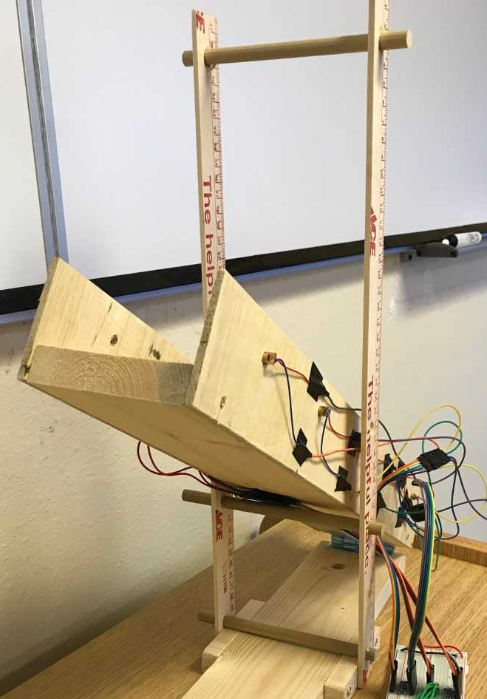
The Ramp
The ramp has two removable pegs
  The bottom peg is used to hold the vertical structures up (Remove the peg to fold the structures down for storage)
  The middle peg is used to adjust the angle of the ramp. The holes on the vertical structure correspond to angles of approximately 15°, 30°, and 45°

Slide 11

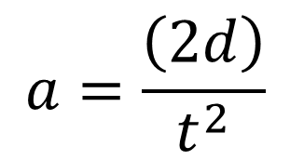
Code 1: Getting the Total Time
Open “LaserTimerSkeleton.ino”
This code uses only two gates to measure the total time required for an object to move between the first and last gate
Assuming no initial velocity, the code can also calculate the constant acceleration using the formula:
$$a=\frac{\left(2d\right)}{t^{2}}$$
Where: a = acceleration
d = distance
t = total time
As well as the final velocity using the formula:
$$v=at$$
Where: v = velocity

Slide 12
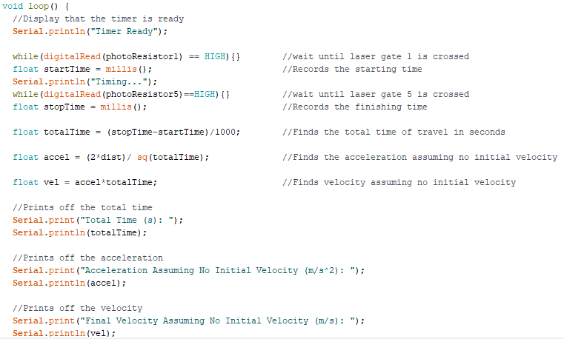
Code for “LaserTimerSkeleton.ino”

Slide 13
Try it out
Upload the code to the Arduino
Open the Serial Monitor in the top right-hand corner
Once the message “Timer Ready” appears, roll a ball down the ramp starting as close to Laser 1 as possible
Notes: Please catch the ball at the end of the ramp

Slide 14
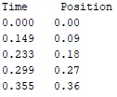
Code 2: Getting Position vs. Time
Open and upload “LaserTimerPosition.ino”
  This code uses the same method as before to track when the each of the 5 gates is crossed
Open the Serial Monitor and roll a ball down the ramp
The code will give a Position vs. Time table similar to this:

Slide 15
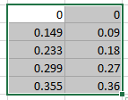
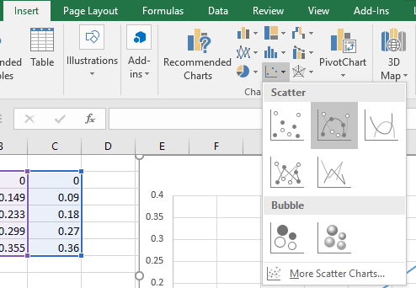
Plotting Position vs Time
Open Microsoft Excel
Enter the values from the table
Highlight all the values
Click on Insert -> Scatter Chart -> Scatter With Smooth Lines

Slide 16
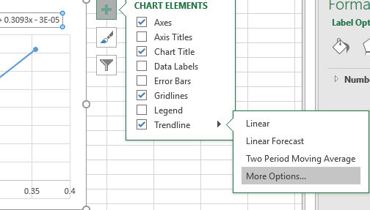
Adding a Best Fit Line
Once you have your plot, click on the + -> Trendline -> More Options
Select polynomial (order 2) and check the “Display Equation on Chart” box

Slide 17
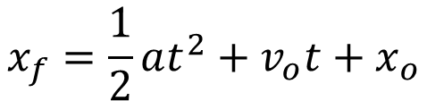
Interpreting the Data
Your plot should look something like this:
The provided equation is in the standard format connecting distance, acceleration, and velocity
$$x_{f}=\frac{1}{2}at^{2}+v_{o}t+x_{o}$$
Where: xf = final distance
a = acceleration
vo = initial velocity
xo = initial distance
t = time

Slide 18
Conservation of Momentum
The same setup can be used for experiments involving conservation of momentum
Momentum = mass x velocity
Conservation of momentum: total momentum is constant before and after a collision if no external force acts upon the system
There are two main types of collisions:
  Inelastic: when the two objects stick together after the collision
  Elastic: when the two object split after the collision

Slide 19
Code 3: Elastic Collision 1
This code is for an elastic collision where one object is initially moving from gate 1, and the other sits still in the middle of the ramp
The two objects should roll separately towards gate 5 after the collision
The code will give the initial velocity of the first moving object, the velocity of the second object after the collision, and the velocity of the first object after the collision

Slide 20
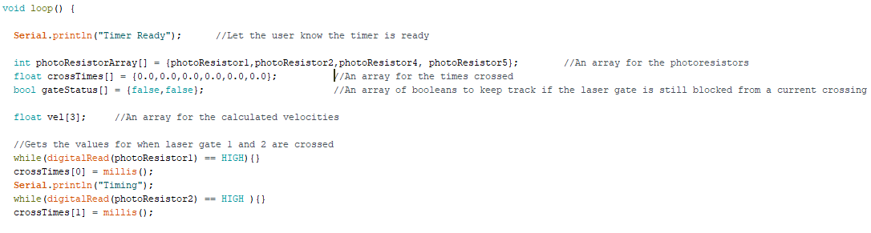
Code 3
Open “Elastic1Skeleton.ino” under the folder LaserTimerMomentumSeparate and type the following code

Slide 21
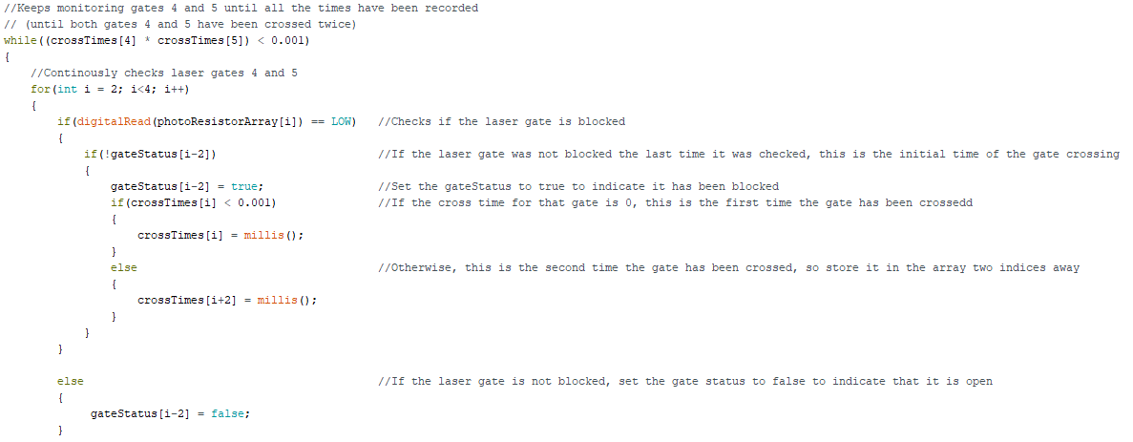
Code 3 Continued
This portion of the code continuously checks gates 4 and 5 until they are both crossed twice

Slide 22
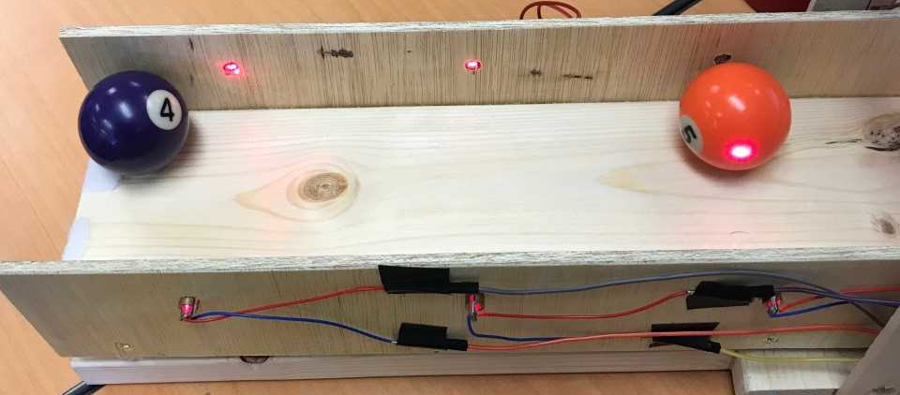

Try It Out
Slightly tilt the ramp structure, so the laser side is higher up
Place one of the pool balls in the middle
Roll the other pool ball from gate 1, so it collides with the other ball
  Make sure you roll the ball hard enough that both balls roll past gate 5
What you should notice:
  The sum of the two post-collision velocities should be close to the initial velocity (it will be slightly off due to friction)
$$mv_{1}=mv_{2}+mv_{3}$$

Slide 23
Code 4:
The folder “LaserTimerMomentumSeparate” contains 4 files, each of which are used for a different type of collision
  Look at these files if you would like to see how the programs work for different types of collisions
The file “LaserTimerMomentumTotal.ino” contains a program, which asks the user what type of collision they want. It, then, runs the function for that type of collision
Upload this code and test out Elastic 2 (mode 4) with the pool balls
Note: In order to get accurate results for the inelastic collisions, you would need close to friction-less carts, which attach to each other

Slide 24
Troubleshooting
If you are getting very incorrect values:
  Make sure the lasers are directed onto the photoresistors. If the light is not directly on the photoresistors, the levels of the voltage may not vary enough to be detected.
  Make sure all the photoresistors are proper connected with the wires

