Slide 1
Autonomous Indoor Drone
Henry O’Meara, Jeffrey Wen
Advisor: Suresh Muknahallipatna

Slide 2
Background
  Applications of autonomous, indoor drones
    Aiding in search and rescue
    Large area inspections (buildings, aircraft carriers, etc.)
    Temporary security
  Challenges of indoor flight
    No Global Positioning System (GPS)
    Requires object avoidance
    Navigating an unknown environment
    Size limitations

Slide 3
Project Goals
Achieve stable indoor flight
Develop a path planning algorithm
Create a map of a traversed path

Slide 4
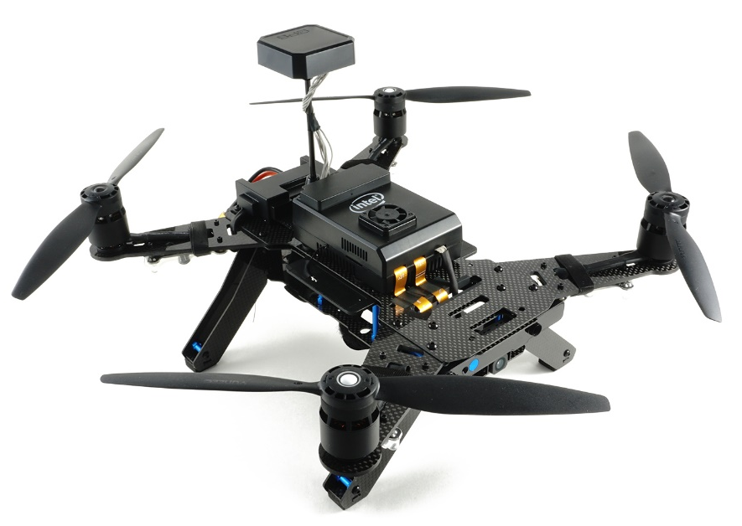
Drone Selection
Required Features
  Programmable
  Suitable size for indoor flight
  Customizable for additional sensors
Considered Drones
  DJI Tello
  DJI Matrice 100
  Custom-Built Drone
Selection: Intel Aero Ready-to-Fly Drone
  Onboard Intel Aero compute board
  Medium-sized
  Room for additional sensors
  Reasonably priced ($1099)

Slide 5
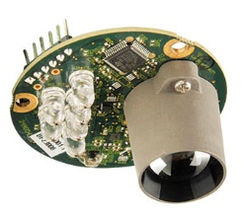
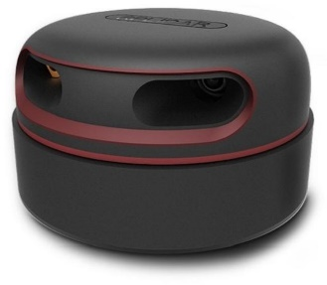
Indoor Flight
Sensor Interfacing
  LeddarOne – Downward facing Light Detection and Ranging (LiDAR) sensor for accurate height estimation
  RPLidar A2 – 2D 360° LiDAR sensor for position estimation
Dronekit
  An Application Programming Interface (API) for communicating with drones
  Written for Python
  Utilizes the MAVLink messaging protocol
BreezySLAM
  Simultaneous Localization and Mapping (SLAM) library written by Dr. Simond Levy
  Python, C, Matlab support
  Provides (x,y) coordinates and map of surroundings

Slide 6
Hardware Diagram
Inertial Measurement Unit
Downward-Facing LiDAR
*Added Hardware
Stereo Camera
Onboard Computer
Flight Controller
Downward-Facing Camera
Altera MAX FPGA
Intel Atom Processor
STM Microcontroller
Motors
2D LiDAR
*Added Hardware

Slide 7
Software Diagram
Horizontal 2D LiDAR Data
Distances/Angles
Onboard Computer
BreezySLAM Algorithm
Current X, Y, and ϴ
Current X, Y, and ϴ
Path Planning Algorithm
Desired X, Y, and ϴ
Vertical 1D LiDAR Data
Height
PID Control Algorithm
Roll, Pitch, Yaw, and Thrust
MAVLink Protocol Wrapper
MAVLink Messages
Height
Flight Controller
Pulse Width Modulation Signals
Motors

Slide 8
Troubleshooting
Inaccurate barometer readings
Inherent drift
Sudden altitude drop
  Attempted solutions:
    Changing flight parameters
    PID tuning (both flight controller and onboard control systems)
    Changing flight controller firmware
    Switching to a larger discharge-rating battery
  Final problem evaluation:
    Propeller guards prevented enough thrust to correct for height drop

Slide 9
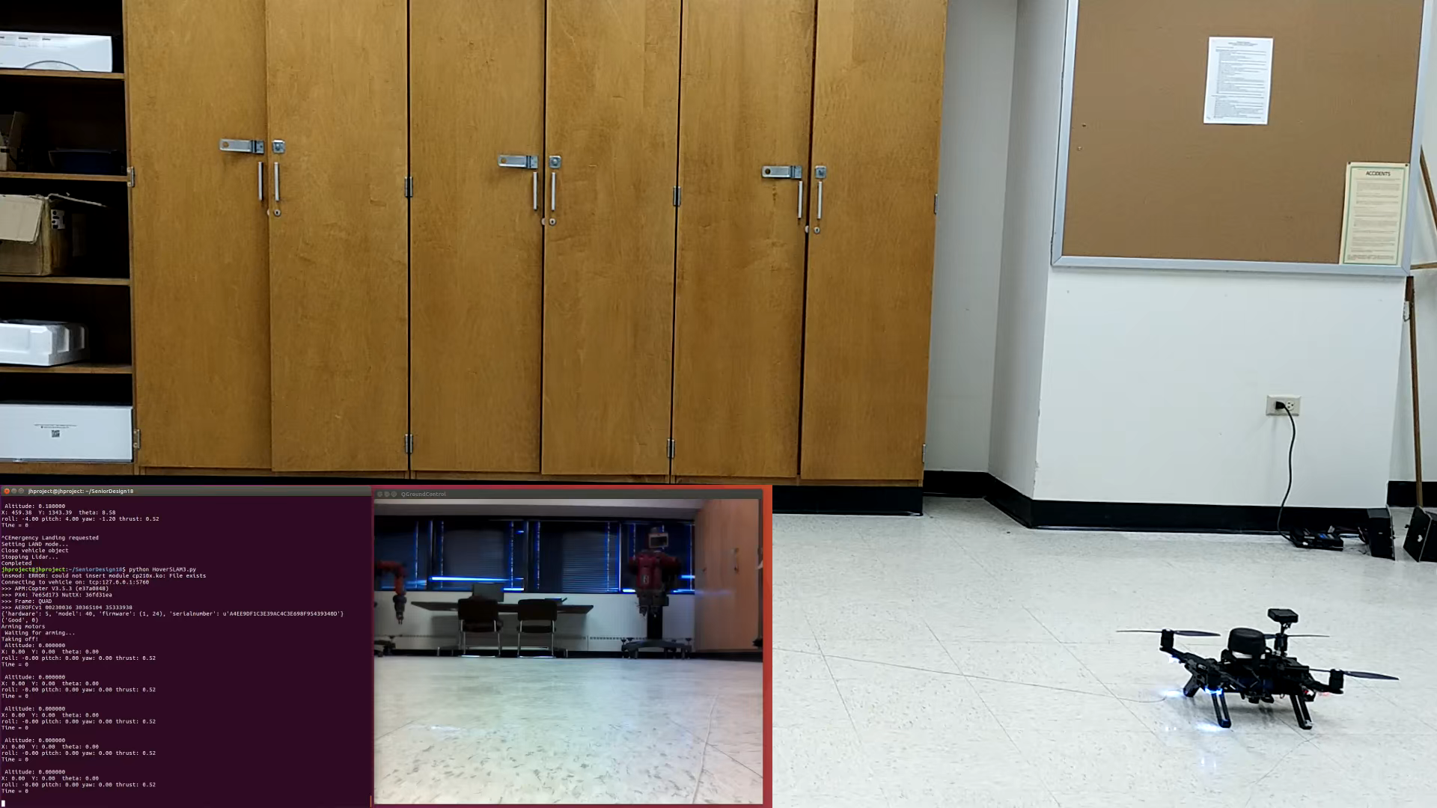
Hover and Navigation Test

Slide 10
Path Planning Algorithm
y
x
Steps:
Find (x,y) of LiDAR detected objects
Determine (x,y) of points 1 m around current position (potential waypoints)
Calculate minimum distance to any object for each potential waypoint
Set desired position to the waypoint with the greatest minimum distance to any object
Set previous location as an object
Compute next waypoint when the current position is within 0.5 m of the desired position

Slide 11
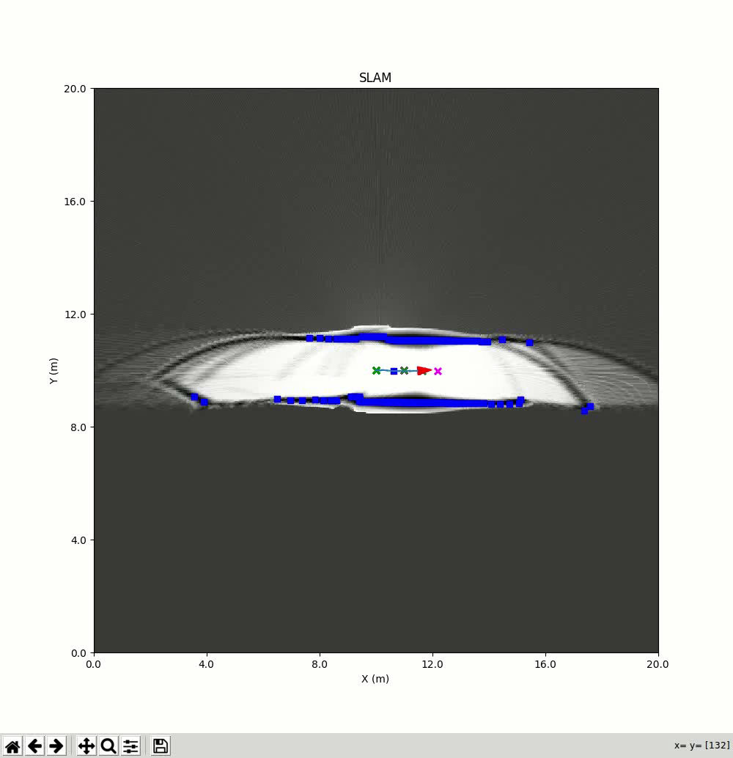
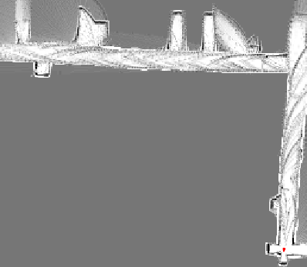
Path Planning Testing
Study Room
Computer Lab
Stairwell
N
W
E
S
Bathrooms

Slide 12
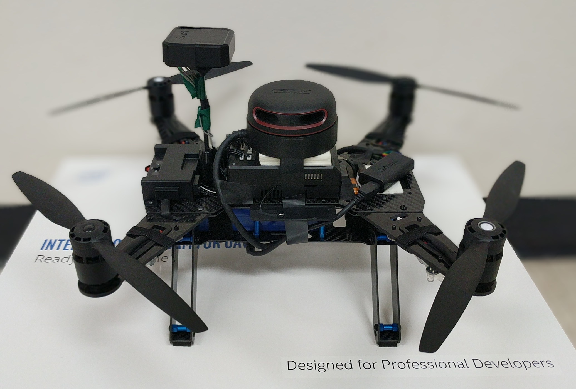
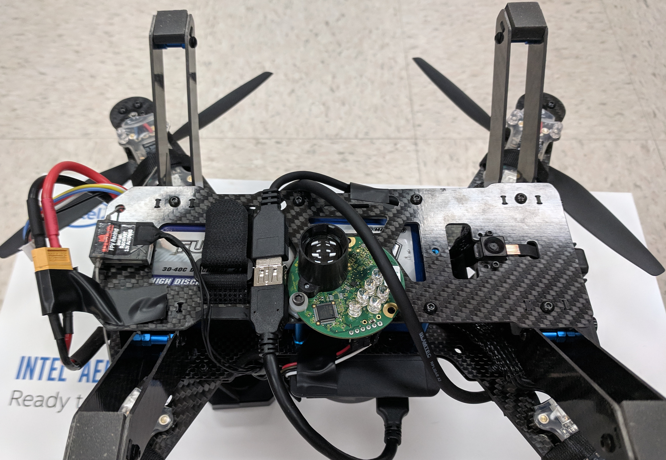
Packaging

Slide 13
Costs Summary
Intel Aero Ready-to-Fly Drone - $1099
RPLidar A2 - $299
LeddarOne LiDAR - $109
4000mAh 4S LiPo Batteries - $85
Smart LiPo Battery Charger - $50
Miscellaneous Smaller Items - $71
Total Project Costs: $1712
Funded by: Dr. Suresh Muknahallipatna

Slide 14
Other Considerations
Ethical: could save lives if used correctly
Social: n/a
Political: potential military impacts
Health and Safety: obstacle avoidance, use of propeller guards
Environmental: use of non-biodegradable material and chemical batteries
Aesthetics: location of sensors, wiring
Manufacturability: custom design limitations
Sustainability: battery cycles
Appropriate Governing Standards: Federal Aviation Administration (FAA) rules and regulations

Slide 15
Conclusions
Drone is able to autonomously hover
Drone is able to autonomously navigate to given (x,y) coordinates
Path planning algorithm is able to determine a waypoint in the most-open direction
Fifth floor of engineering building successfully mapped manually
Drone and path planning subsystems were not fully integrated together

Slide 16
Skills Learned
Working with Linux OS
Flight controller firmware and tuning
Utilizing LiDAR data to develop algorithms
Control system development

Slide 17
Future Work
Integrate the drone control code with the path planning algorithm
Utilize the stereo camera for 3D mapping and obstacle avoidance
Explore more dynamic path planning algorithms

Slide 18
Acknowledgements
Dr. Suresh Muknahallipatna
Dr. Steven Barrett
Vic Bershinsky

Slide 19
Bibliography
Levy, S (2014) BreezySLAM (Version 3.0) [Source Code]. https://github.com/simondlevy/BreezySLAM
Levy, S (2018) PyRoboViz (Version 3.0) [Source Code]. https://github.com/simondlevy/PyRoboViz
3D Robotics (2015) Dronekit (Version 2.0) [API]. https://github.com/dronekit/dronekit-python

